Slide 1





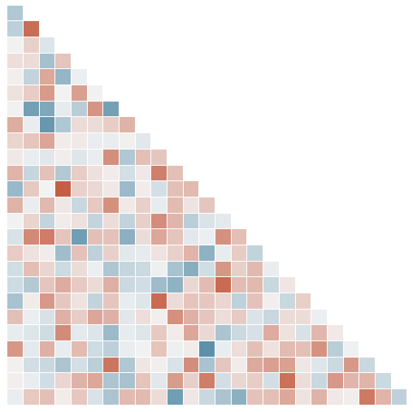
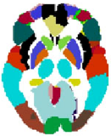

Collect 884 data from ABIDE
Harmonized with Combat
Report Analysis
Train Model
Map to Atlas
ROI extraction
x.y.z.T
Map to specific atlas
1
T
ROI 1
ROI 2
…
…
TR1
TR2
TR3
T
ROI N
Vectored

